Slide 1

An Introduction to backend as a service
Making the cloud work for you
Sean Durkan

Slide 2

What is back-end-as-a-service? Why you need Baas
Got Baas?
A complete back-end service
Our features
How our customers use it

Slide 3




Backend as a service
Social
Live chat
Leaderboards
Challenges
Friends and teams
Events and tournaments
Cloud Storage
Player Account Details
Inventory
Player Progress
etc..
IAPs & Storefronts
Analytics
Meta-Currency
Virtual goods
Store Integrations
Receipt Validation
DAU, MAU
Retention
Session Duration
Key Events
ARPDAU

Slide 4
Backend as a service

Slide 5






Backend as a service
Plugins or SDKs

Slide 6
Why us a Baas Provider?
Saves Development Time Integrated SDK with simple API calls…
All-in-One Service No need for multiple integrations…
Provider Hosts & Maintains Servers
Game Management Configure Live Ops…

Slide 7
GameSparks is a complete Baas Platform
Specializing in Game-Services We currently have…
~170 million players
Over 10,000 registered developers
600 live games
7,000 games in development
At max we’ve hit 540k concurrent users.
Telltale Games, Bandai Namco, Square Enix, Rovio, Amazon Game Studios, Capcom, Ubisoft + others

Slide 8





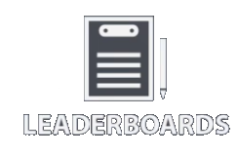

Facebook
Twitter
Google+
Apple
Microsoft
PSN
Steam
Twitch
Kongregate
Viber
WeChat
QQ

Slide 10


Facebook
Twitter
Google+
Apple
Microsoft
PSN
Steam
Twitch
Kongregate
Viber
WeChat
QQ

Slide 11






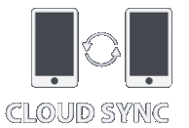
Facebook
Twitter
Google+
Apple
Microsoft
PSN
Steam
Twitch
Kongregate
Viber
WeChat
QQ

Slide 12

GameSparks SDKs
All mobile OS (native and HTML) Javascript, Objective-C and Java
Unity, Unreal, Marmalade, C++, Cocos2d
Node.js & REST apis
Playstation and XBox approved

Slide 13

Platform-as-a-Service with exceptional usability
Authentication
Cloud code (custom logic)
Events (custom API calls)
API test harness
Cloud code debugging
Cloud data
Binary file management
Messaging, include push notifications
Geo-location
Dashboard analytics
Application versioning
Full database access and export
CORE

Slide 14

High quality integrations with all leading game development tools
Supporting all major games platforms - mobile, PC and console
Integrations with all leading social networks and app stores
Integrations with Real Money Remote Gaming Systems
COMPATIBLE
CORE

Slide 15

INFRASTRUCTURE MANAGEMENT BRINGS PEACE OF MIND
Multi-vendor IaaS sourcing
99.9% availability
Dynamically scalable
Triple replication of data
24x7 monitoring
Best-in-class operations centre
MANAGED SERVICES
COMPATIBLE
CORE

Slide 16

CUSTOMISABLE, CROSS VERTICAL TOOLS TO BUILD IN-GAME ECONOMIES
Non-monetary currencies and XP
Virtual goods - inventory & management
In-app purchases
Anti-fraud controls
Rewards
Achievements
BUILD ECONOMIES
MANAGED SERVICES
COMPATIBLE
CORE

Slide 17

CUSTOMISABLE, CROSS-VERTICAL TOOLS FOR SOCIAL & MULTIPLAYER
Friends lists
Teams and clans
Matchmaking
Chat and P2P messaging
Leaderboards
Multiplayer - turn-based
Multiplayer - real-time
Challenges
Sharing and gifting
Tournaments
BUILD SOCIAL
BUILD ECONOMIES
MANAGED SERVICES
COMPATIBLE
CORE

Slide 18

MANAGING AND OPTIMISING YOUR GAME POST LAUNCH
Player profiles
Player management
Customer service
Segmentation
Experimentation (A/B testing)
Custom analytics and dashboards
Custom management screens
Roles and permissions
Abuse reporting and banning
MANAGE & OPTIMISE
BUILD SOCIAL
BUILD ECONOMIES
MANAGED SERVICES
COMPATIBLE
CORE

Slide 19
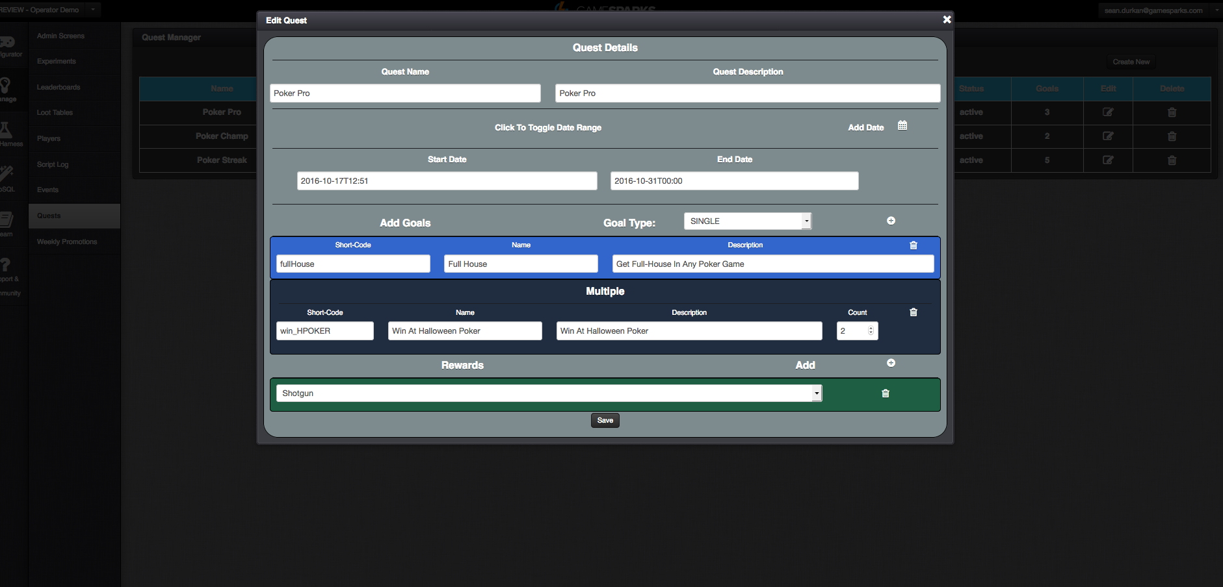

Slide 20
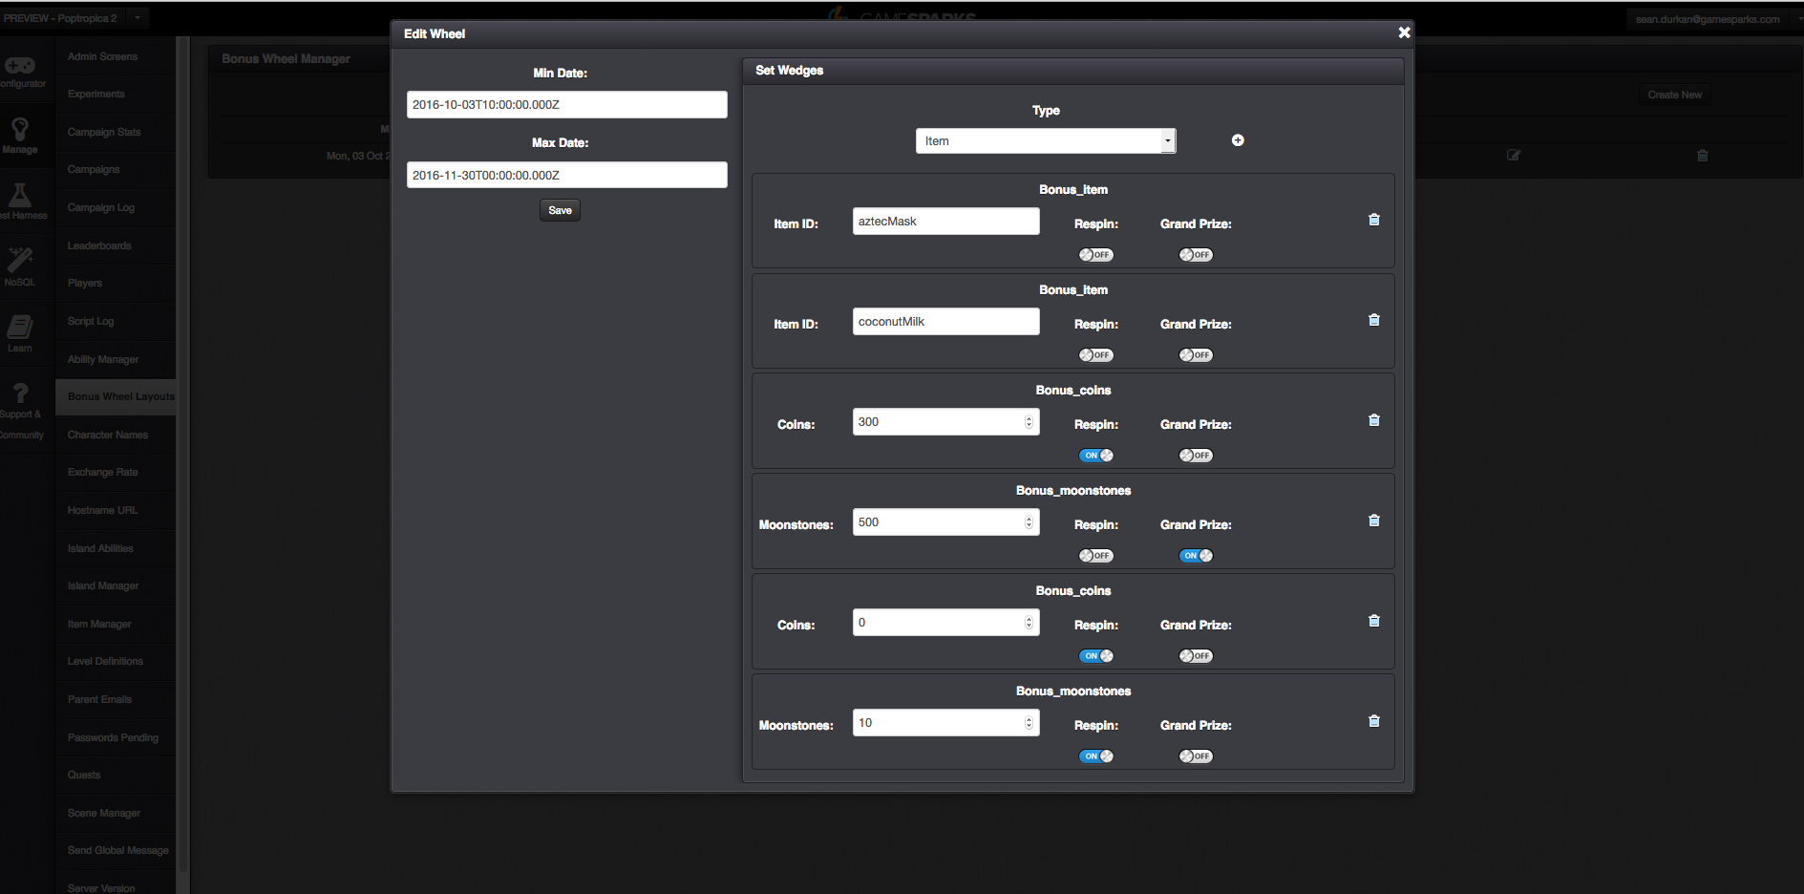

Slide 21
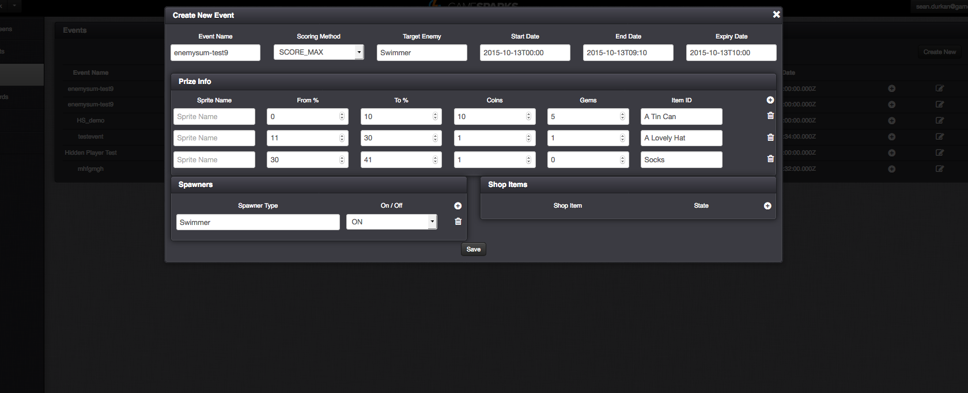

Slide 22
Casual Game Case Study:
Lara Croft - Relic Run
Key mobile title released by Square Enix featuring their strongest IP
GameSparks supports:
player profiles
currencies
in-app purchases
multiplayer and matchmaking
game state persistence
game management
scheduled push campaigns / notifications

Slide 23
Casual Game Case Study:
Hungry Shark
Smash hit game from Ubisoft owned FGOL
Existing game, re-invigorated by addition of Weekly Live Events
Implemented in under 4 weeks, from start to finish
Significant increase in engagement
FGOL can create new events as they like, notify their players and invite them to compete over the course of a tournament which usually lasts a week. Different goals can be set by event or tournament and winners tracked in leaderboards and prizes are automatically rewarded

Slide 24


Casual Game Case Study:
MMX Racing
Chart topper from Hutch Games in London:
GameSparks supports:
player profiles
currencies
in-app purchases
multiplayer and matchmaking
game state persistence
game management
push campaigns & notifications
leaderboards

Slide 25
7 Days to Die
Key Use Cases
Analytics
Dynamic Loot Management
Heat Mapping
Persistent Player Data
Inventory, position etc
Prevent item duplication
Store / Share building prints
Companion Apps

Slide 26
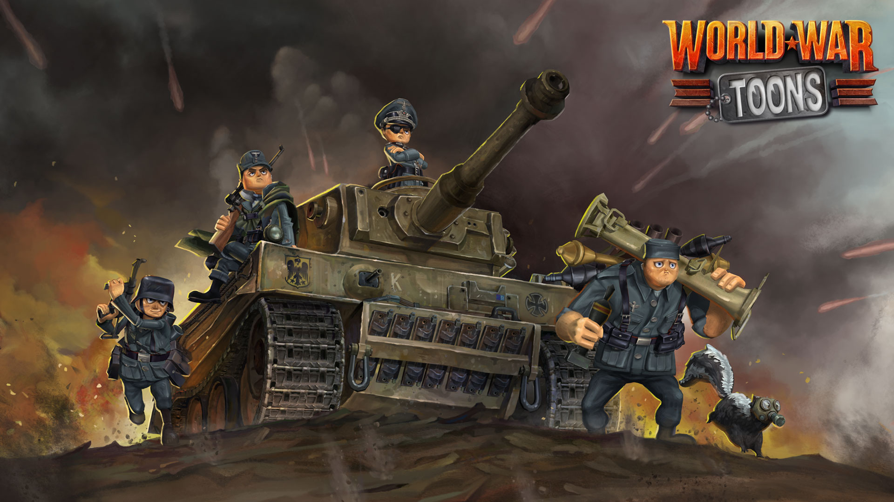
World War Toons
Key Use Cases
Persistent Player Data
Inventory, load-outs
Randomisation
Card Packs
PSN Entitlement Integrations
Customer Support Management

